Slide 1
TEaM
NO PAIN,NO GAIN

Slide 2
TEAM MEMBERS
RABBI HASAN 152-35-1199
MOMINUL ISLAM 152-35-1190

Slide 3
PROJECT NAME
GRE HIGH FREQUENCY DICTIONARY

Slide 4
BACKGROUND STUDY
Study c language in class room.
Google search , watch tutorial etc.
Discuss friends , senior brothers and teacher.

Slide 5
Requirements

Slide 6
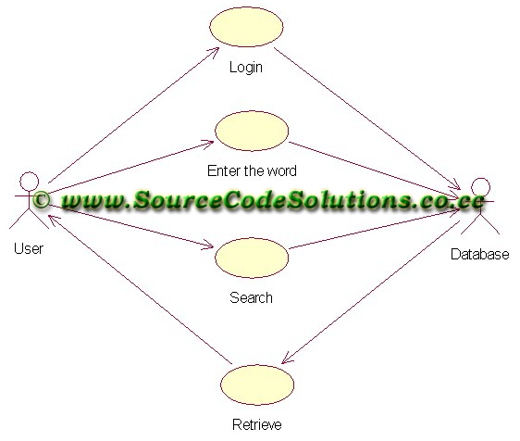
Use case diagram

Slide 7
Design

Slide 8
Implementation plan

